Slide 1
HEALTH INFORMATION & BASIC MEDICAL STATISTICS
Dr. Reshma Reghu
Lecturer,
Dept of Community Medicine

Slide 3
PRIMARY OBJECTIVE
To provide reliable, relevant, up-to-date, adequate, timely and reasonably complete information for health managers at all levels (i.e., central, intermediate and local), and at the sharing of technical and scientific (including bibliographical) information by all health personnel participating in the health services of a country
to provide at periodic intervals, data that will show the general performance of the health services
to assist planners in studying their current functioning and trends in demand and work load.

Slide 6
COMPONENTS
Demography & Vital events
Environmental health statistics
Health Status
Health Resources
Utilization & Non- utilization of health services
Indices of outcome of medical care
Financial statistics

Slide 9
CENSUS
A census is defined by the United Nations as "the total process of collecting, compiling and publishing demographic, economic and social data pertaining at a specified time or times, to all persons in a country or delimited territory“
Population census provides basic data (such as population by age and sex) needed to compute vital statistical rates, and other health, demographic and socio-economic indicators.

Slide 11
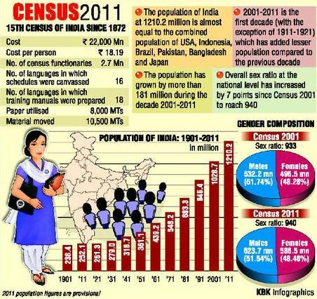

Slide 12
REGISTRATIONOF VITAL EVENTS
The United Nations defines a vital events registration system as including "legal registration, statistical recording and reporting of the occurrence of, and the collection, compilation, presentation, analysis and distribution of statistics pertaining to vital events, i.e., live births, deaths, foetal deaths, marriages, divorces, adoptions, legitimations, recognitions, annulments and legal separations"

Slide 15
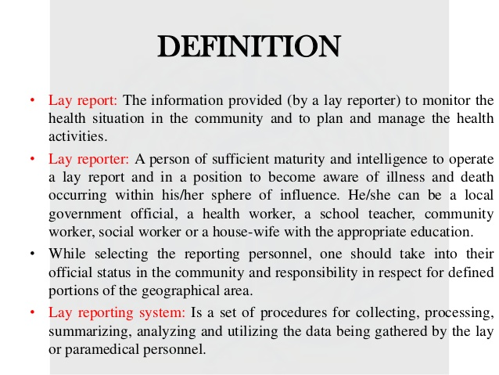

Slide 18
LIMITATIONS
(a) notification covers only a small part of the total sickness in the community
(b) the system suffers from a good deal of under-reporting
(c) many cases especially atypical and subclinical cases escape notification due to non-recognition, e.g., rubella, non-paralytic polio etc.

Slide 20
HOSPITAL RECORDS
The main drawbacks of hospital data are :
They constitute only the "tip of the iceberg" - i.e., they provide information on only those patients who seek medical care, but not on a representative sample of the population. Mild cases may not attend hospitals; subclinical cases are always missed
(b) the admission policy may vary from hospital to hospital
(c) population served by a hospital (population at risk) cannot be defined.

Slide 21
A study of hospital data provides information on the following aspects
(a) geographic sources of patients
(b) age and sex distribution of different diseases and duration of hospital stay
(c) distribution of diagnosis
(d) Association between different diseases
(e) the period between disease and hospital admission
(f) the distribution of patients according to different social and biological characteristics,
(g) the cost of hospital care.

Slide 22
DISEASE REGISTERS
Morbidity registers are a valuable source of information as to the duration of illness, case fatality and survival. These registers allow follow-up of patients and provide a continuous account of the frequency of disease in the community.
If the reporting system is effective and the coverage is on a national or representative basis, the register can provide useful data on morbidity from the particular diseases, treatment given and disease-specific mortality.

Slide 25
OTHER HEALTH SERVICE RECORDS
records of hospital out-patient departments
primary health centres and subcentres
polyclinics
private practitioners
mother and child health centres
school health records
diabetic and hypertensive clinics, etc.

Slide 26
ENVIRONMENTAL HEALTH DATA
air, water and noise pollution
harmful food additives;
industrial toxicants,
inadequate waste disposal
other aspects of the
combination of population explosion with increased production and consumption of material goods.
Environmental data can be helpful in the identification and quantification of factors causative of disease.

Slide 28
HOUSE HOLD SURVEY
The size of the sample, necessary for a household survey, depends upon the measurement being taken and the degree of precision needed. Many national samples typically cover between 5,000 to 10,000 households. This is usually considered adequate for providing national estimates on such variables as health care status, anthropometric measurements, food consumption, income, expenditure, housing, literacy, etc. Surveys carried out by either single or repeat visits provide direct estimates of vital events.
A single survey obtains the necessary information retrospectively and is subject to problems of recall and omission.
Follow-up surveys on the same households within short intervals (e.g., 6 months) appear to provide more accurate estimates of vital events, but may be too expensive for monitoring purposes .
Data must be gathered under standardized conditions with quality control.
The data that is collected should be transformed into information by reducing them, summarizing them· and adjusting them for variations in the age and sex composition of the population so that comparisons over time and place are possible.

Slide 29
Other routine statistics related to health
(1) Demographic : In addition to routine census data, statistics on such other demographic phenomena as population density, movement and educational level.
(2) Economic : consumption of such consumer goods as tobacco, dietary fats and domestic coal; sales of drugs and remedies; information concerning per capita income; employment and unemployment data.
(3) Social security schemes: medical insurance schemes make it possible to study the occurrence of illnesses in the insured population. Other useful data comprise sickness absence, sickness and disability benefit rates.

Slide 30
NON-QUANTIFIABLE INFORMATION
Health policies
Health legislation
Public attitudes
Programme cost

